Slide 1

5G Wizard
5G WIZARD

Slide 2
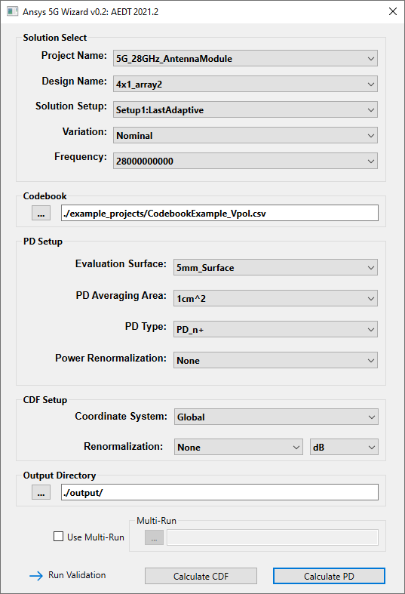
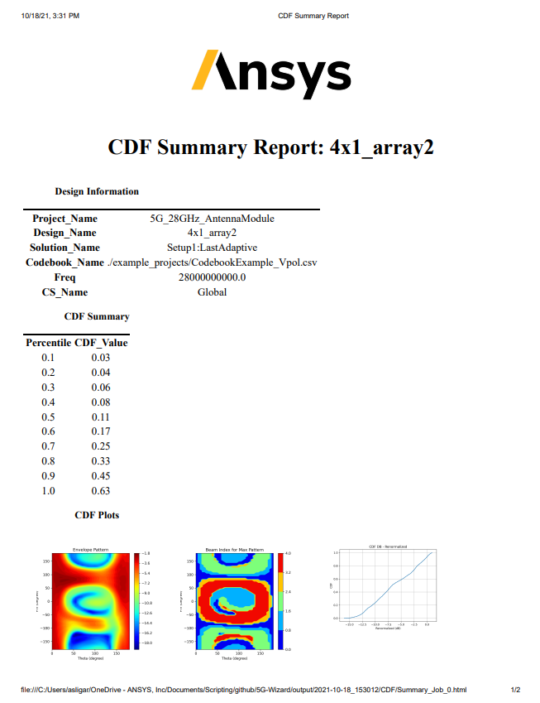
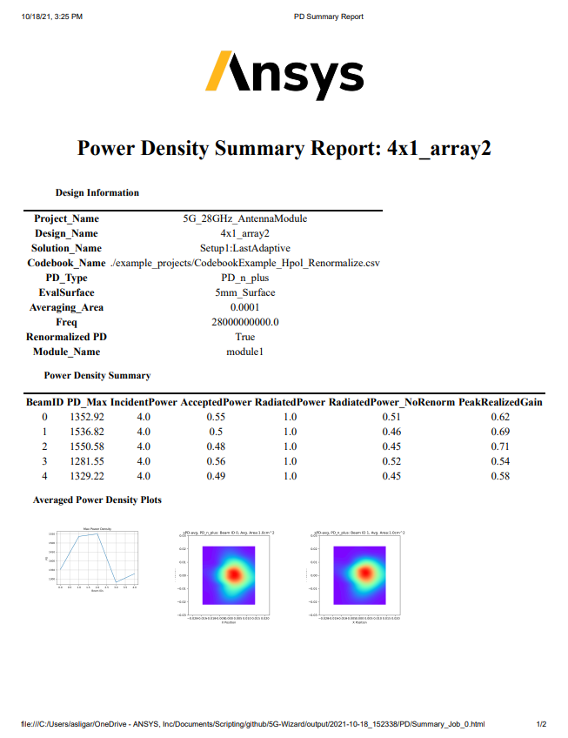
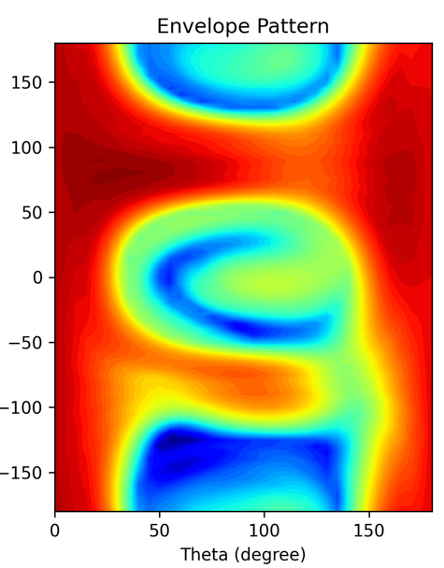
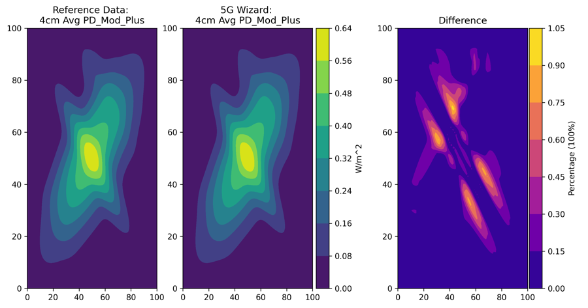
New 5G Wizard
Automation
Batching of multiple calculation
Run any variation of inputs using multi-run calculations
Total CDF calculation over single and multiple projects/designs
Reporting
HTML based reporting
Results also written to JSON and HDF5 files for easy user access
Accuracy
Implemented IEEE defined Power Density calculations (PD_N+, PD_Tot+,PD_Mod+)
Rotating square averaging surface
Validated using IEEE reference data
Speed
100x faster than previous 5G Wizard
Open Source
Built on pyAEDT library
Supports Community Collaboration
Customization to fit any workflow
Publicly available on GitHub

Slide 3
5G Wizard Overview
Calculated maximum permissible exposure (MPE) and Cumulative Distribution Function (CDF) for 5G antenna modules
Radiation Characteristics Controlled by Codebook
Magnitude and phase of antenna ports is defined through external “codebook” csv file
Beam ID defines mag and phase on each port
MPE
Power Density (PD, ie. W/m) evaluated on user defined surface
Peak averaged PD (PD_N_+, PD_Tot_+, and PD_Mod_+)
CDF
Statistical distribution calculated across beam ID’s
Envelope antenna pattern and corresponding beam ID

Slide 4
Cumulative Distribution Function

Slide 5
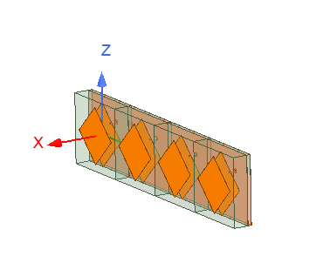
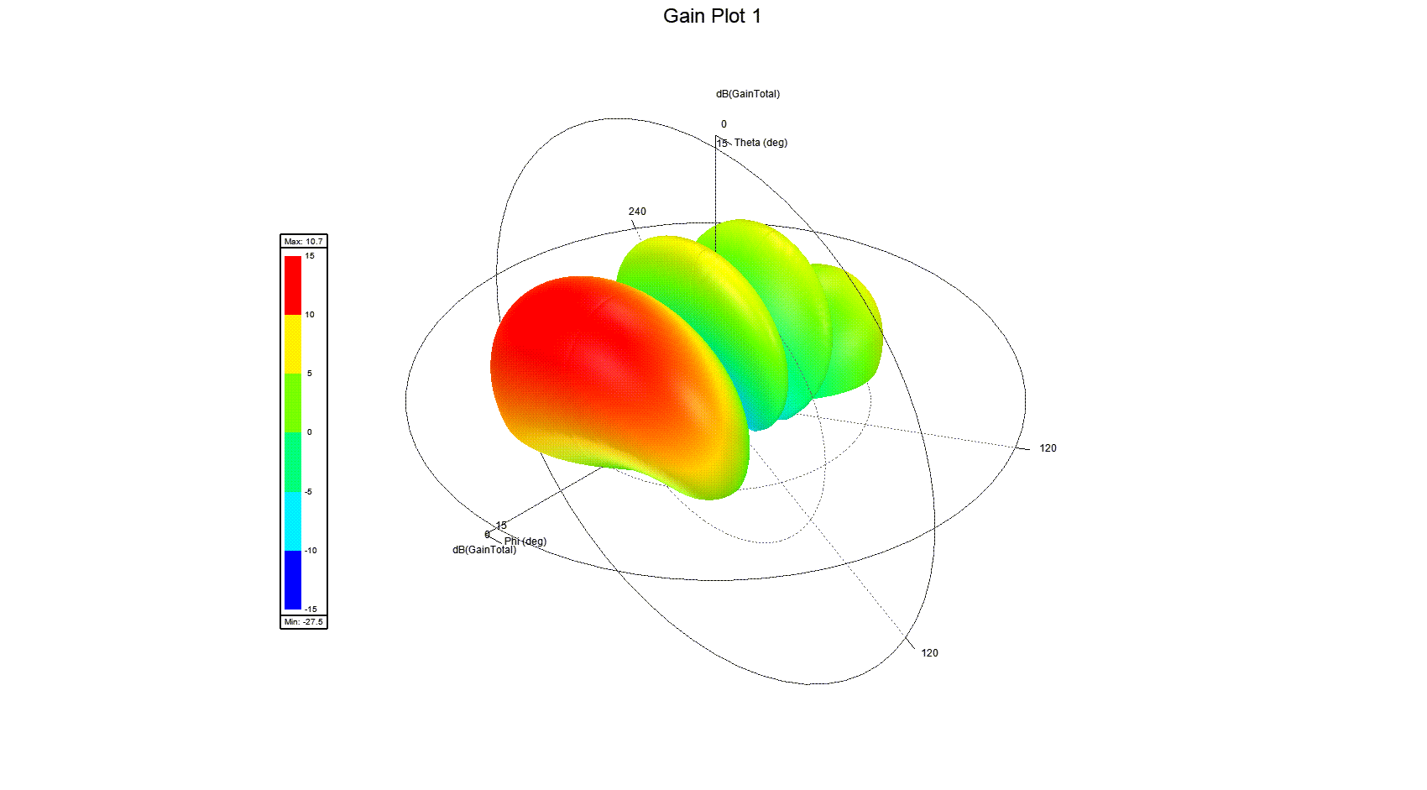
5G antenna array performance modeling
Beam Steering Code Book
Antenna Beam Steering
Antenna beam formed using look-up table: Code Book
Look-up table imported into HFSS
User can control beam by selecting corresponding beam ID
HFSS supports Code Book definition for port excitations
Beam ID | Port 1 | Port 2 | Port 3 | Port 4
1 | 1W @ 0° | 1W @ -145° | 1W @ -290° | 1W @ -435°
2 | 1W @ 0° | 1W @ -84° | 1W @ -168° | 1W @ -252°
3 | 1W @ 0° | 1W @ 0° | 1W @ 0° | 1W @ 0°
4 | 1W @ 0° | 1W @ 84° | 1W @ 168° | 1W @ 252°
5 | 1W @ 0° | 1W @ 145° | 1W @ 290° | 1W @ 435°
Automated
look-up table application to mm-wave array
using scripting
Beam pattern selected by Beam ID post processing variable

Slide 6
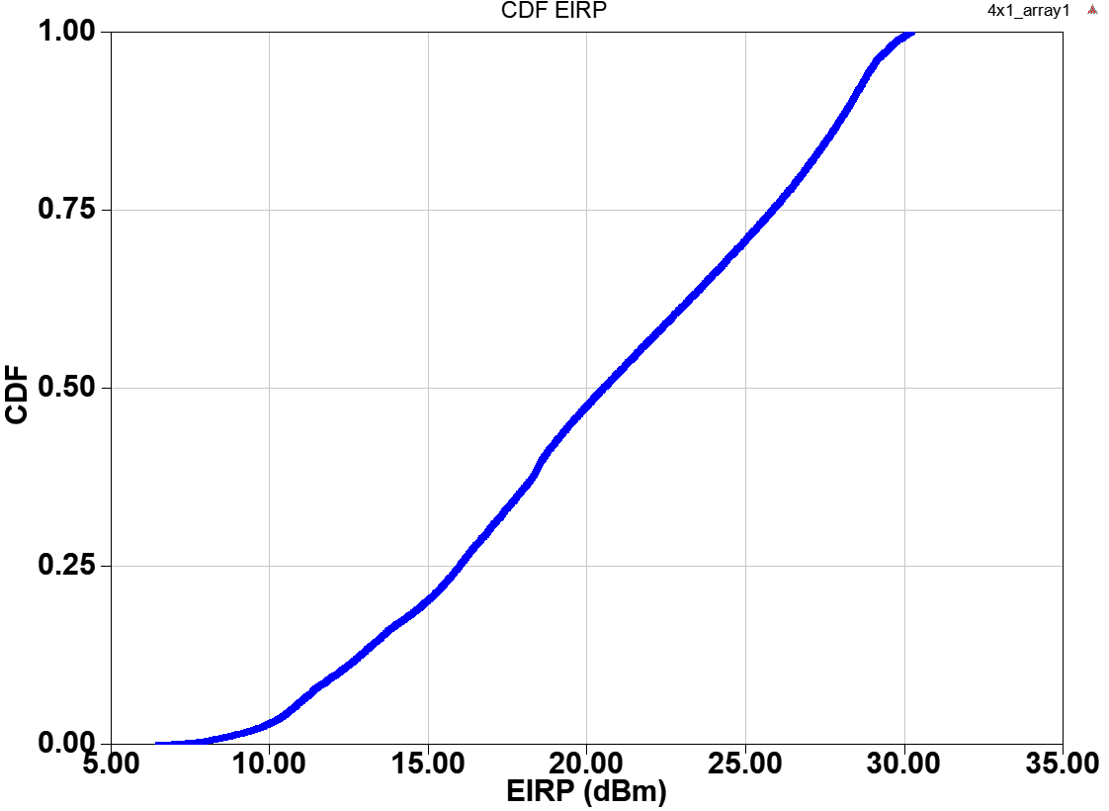
Evaluating spatial coverage capability for 5G mm-wave antennas
Cumulative Distribution Function (CDF) for Antenna Arrays
Statistical analysis of far field quantities that results in the probability that a quantity will be less than or equal to a certain percentage over the entire infinite far field sphere
Example CDF: Probability of device to deliver 20.2dBm EIRP to 50% of observation points

Slide 7
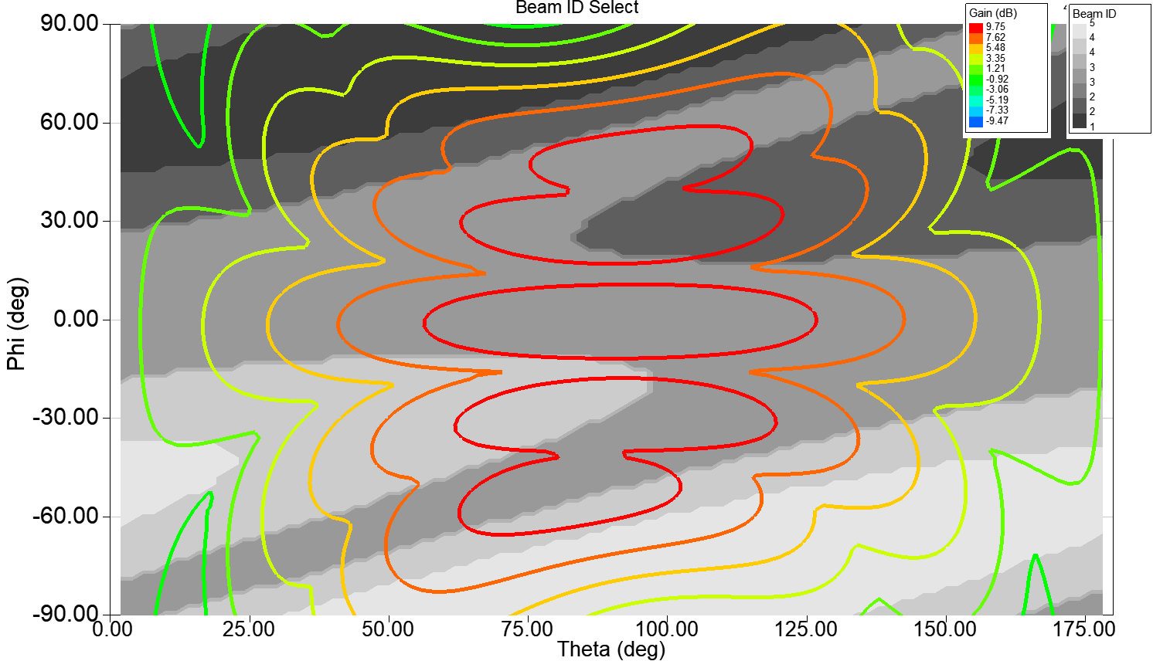
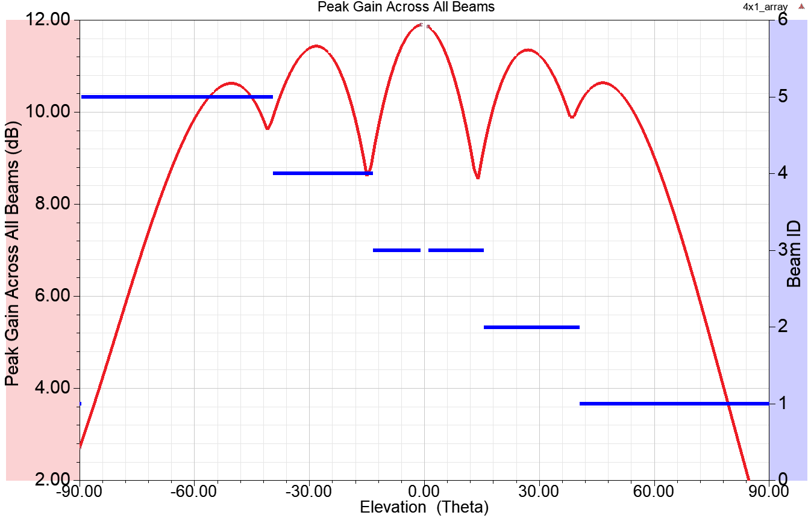
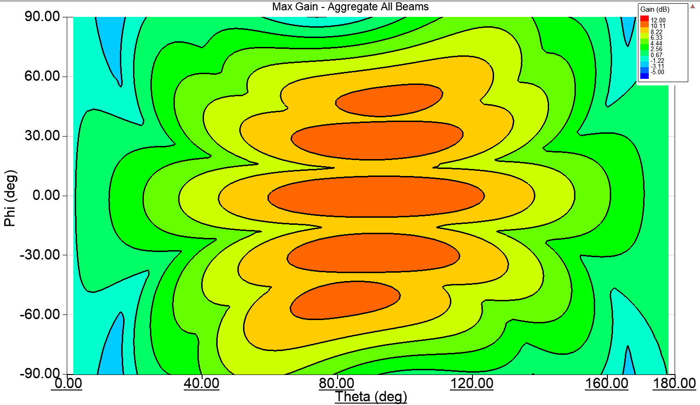
Evaluating CDF efficiently through simulation
View composite illumination capability over all steering angles
Provides insight into antenna system blind spots
2D Radiation Combined Pattern
3D Radiation Combined Pattern (Envelope)
Upper Hemisphere

Slide 8
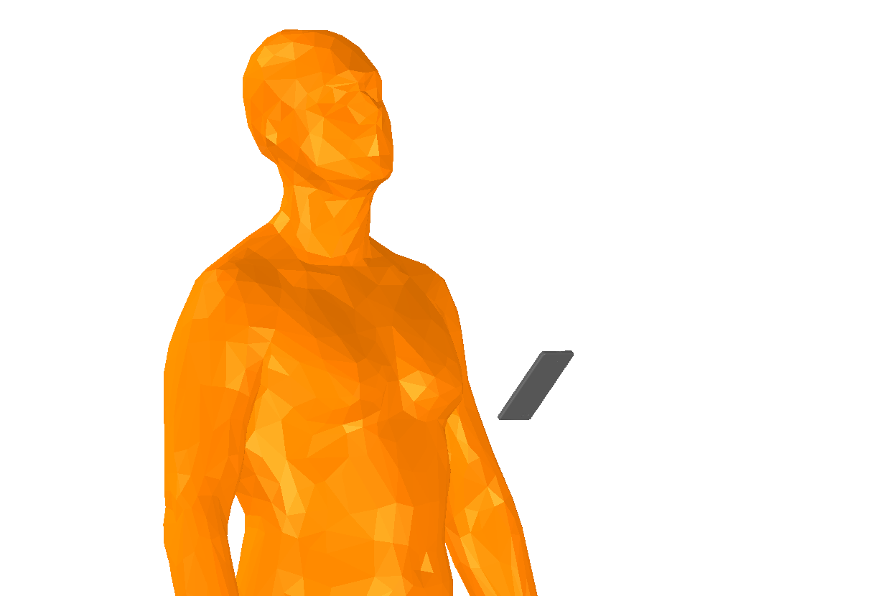
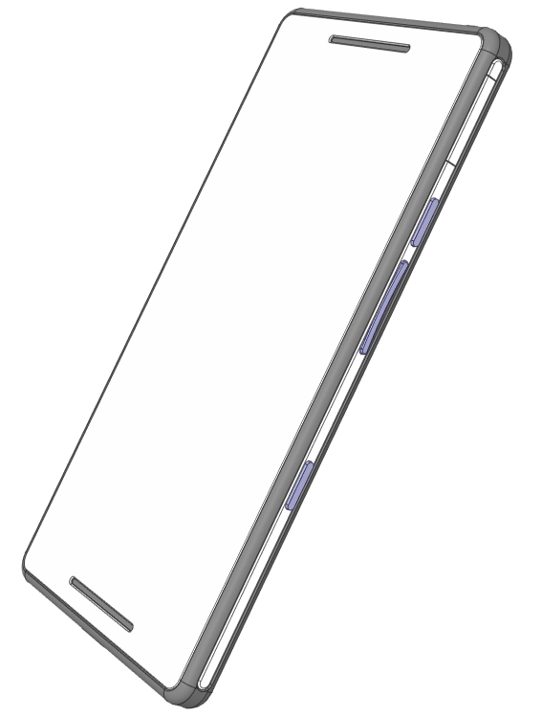
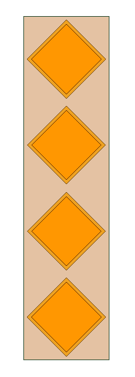
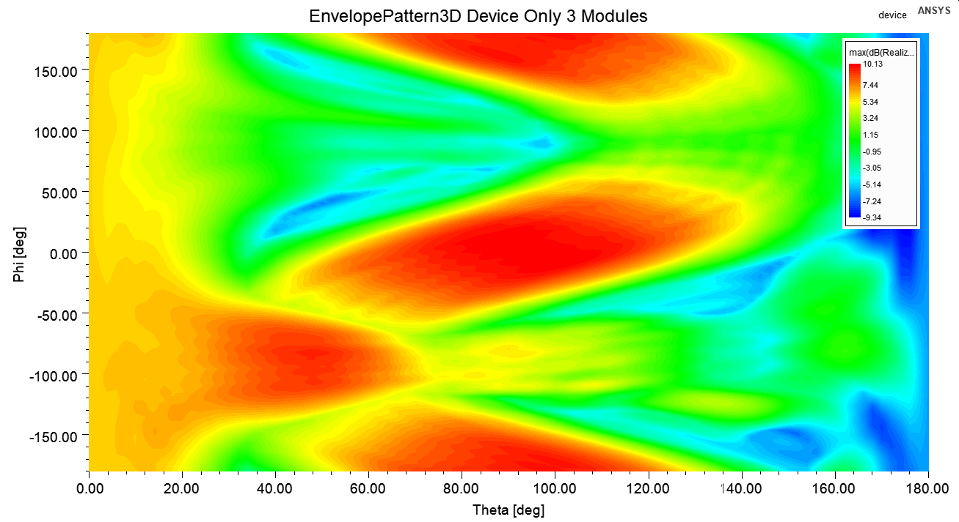
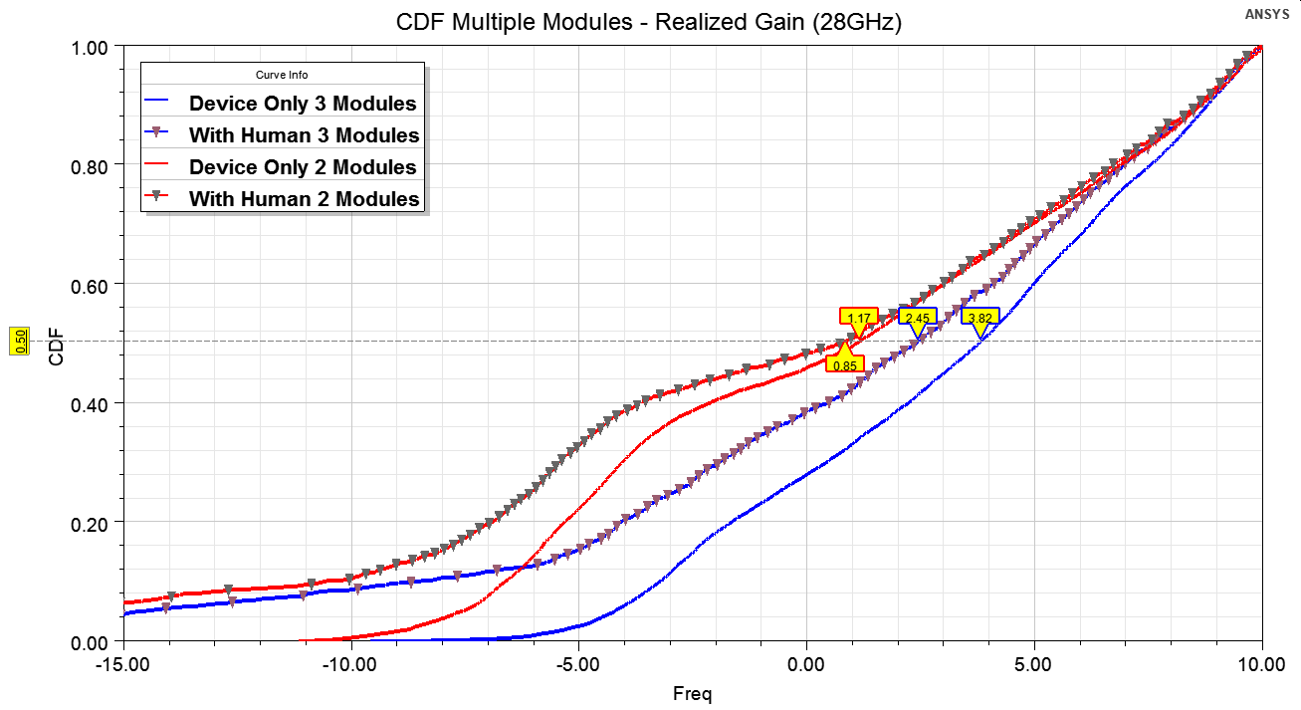
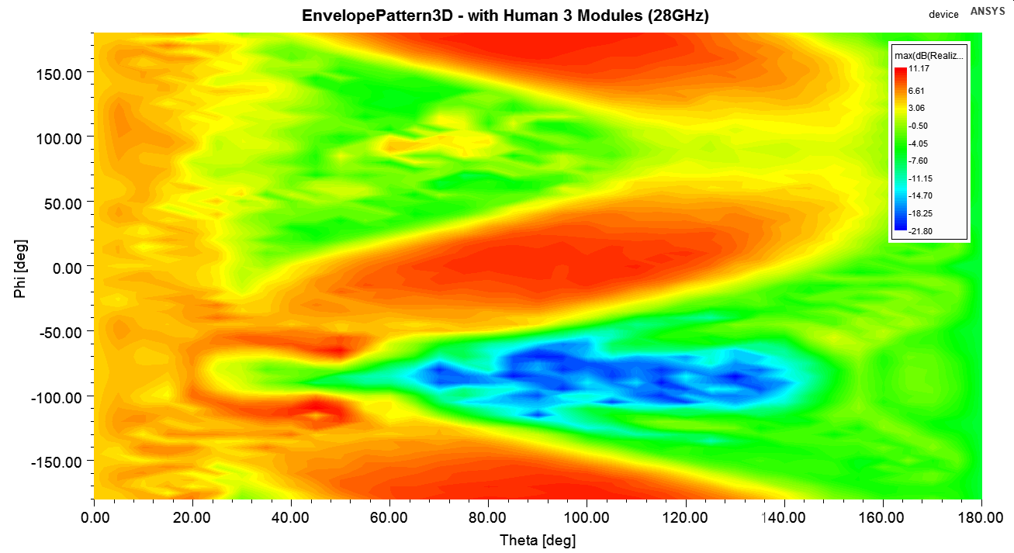
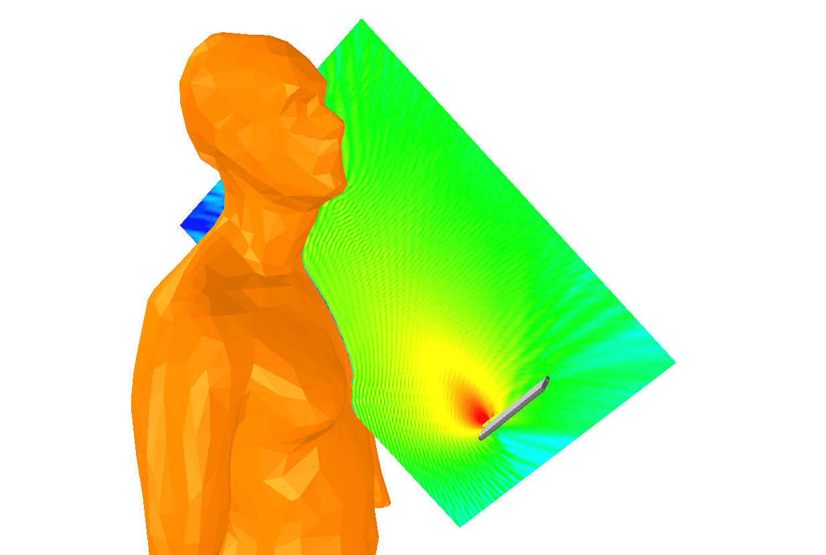
Evaluating human body effects on CDF
Module 3
Module 1
Module 2
Isolated Device CDF Envelope Gain
Phone with 3 mm-wave PAAs
Device only: 3rd array adds 2.6 dB difference in 50th percentile CDF
Device+Body CDF Envelope Gain
Region of Human body
Human body, 3 modules: Body degrades CDF by 1.3 dB
Shadow of Human body
EIRP (dBm)

Slide 9
Power Density

Slide 10
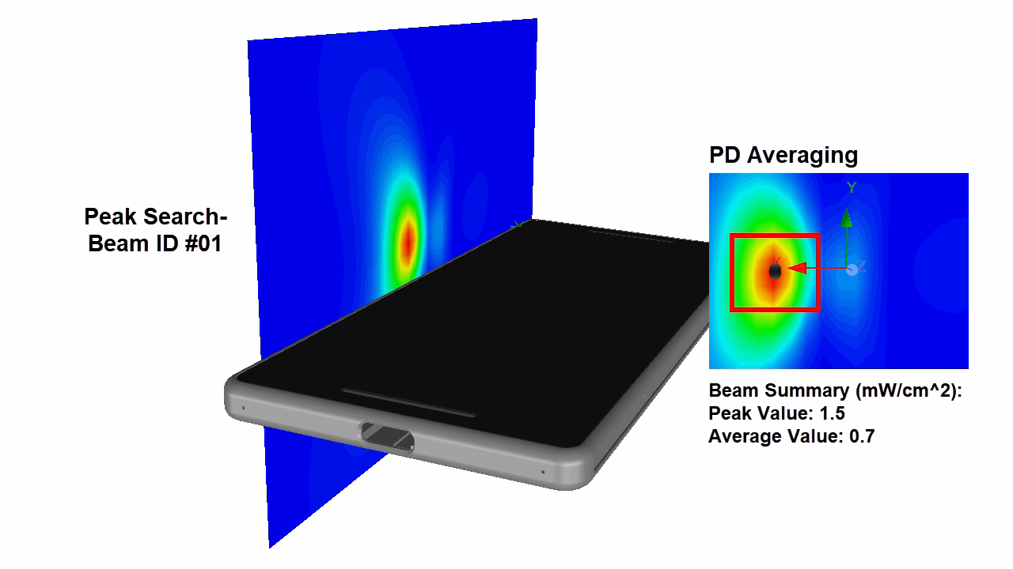
Maximum Permissible Exposure: Power Density
Automated extraction of Power Density enabled by HFSS
Efficient extraction for FCC certification process
Featuring functions such as:
Peak search and detection, area averaging, worst case beam pair phasing
5G Wizard: Automated PD Extraction

Slide 11
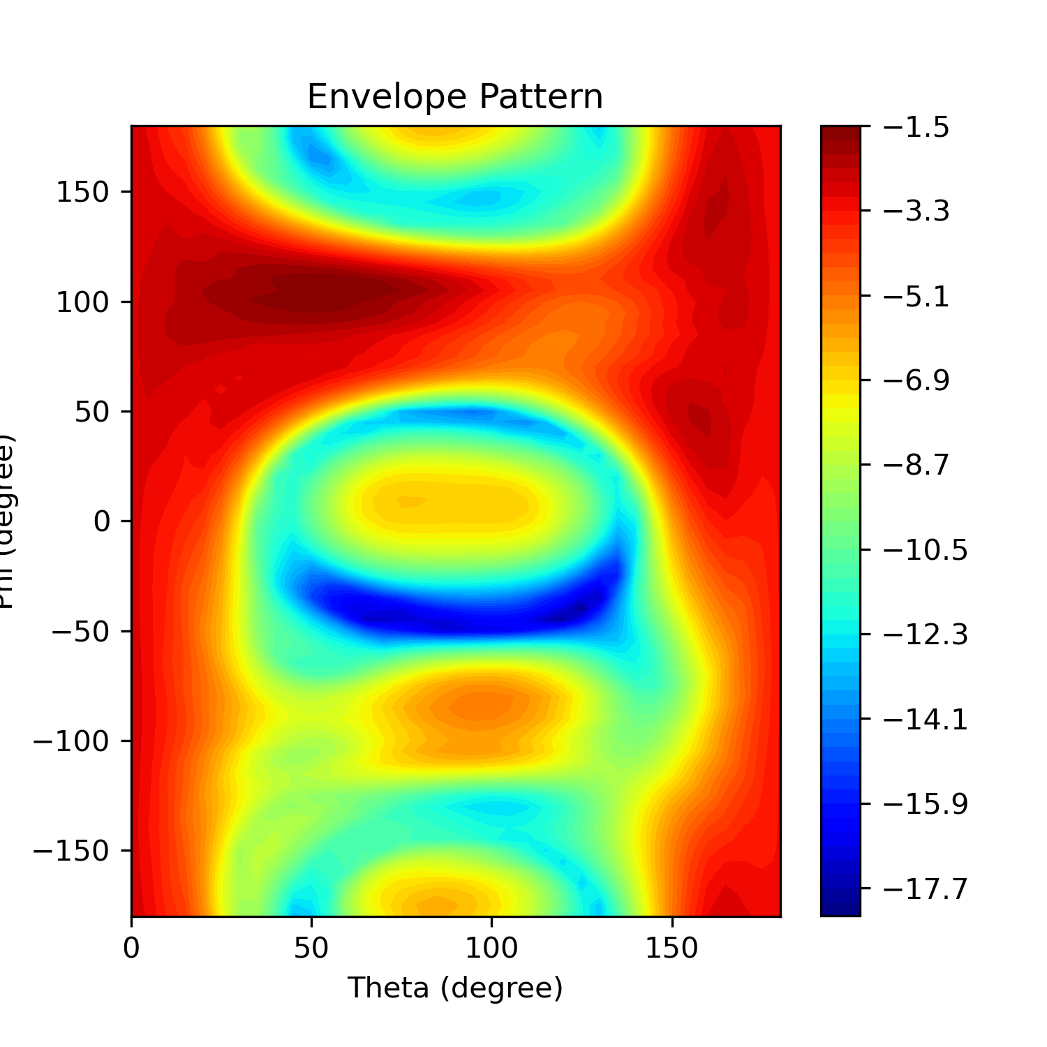
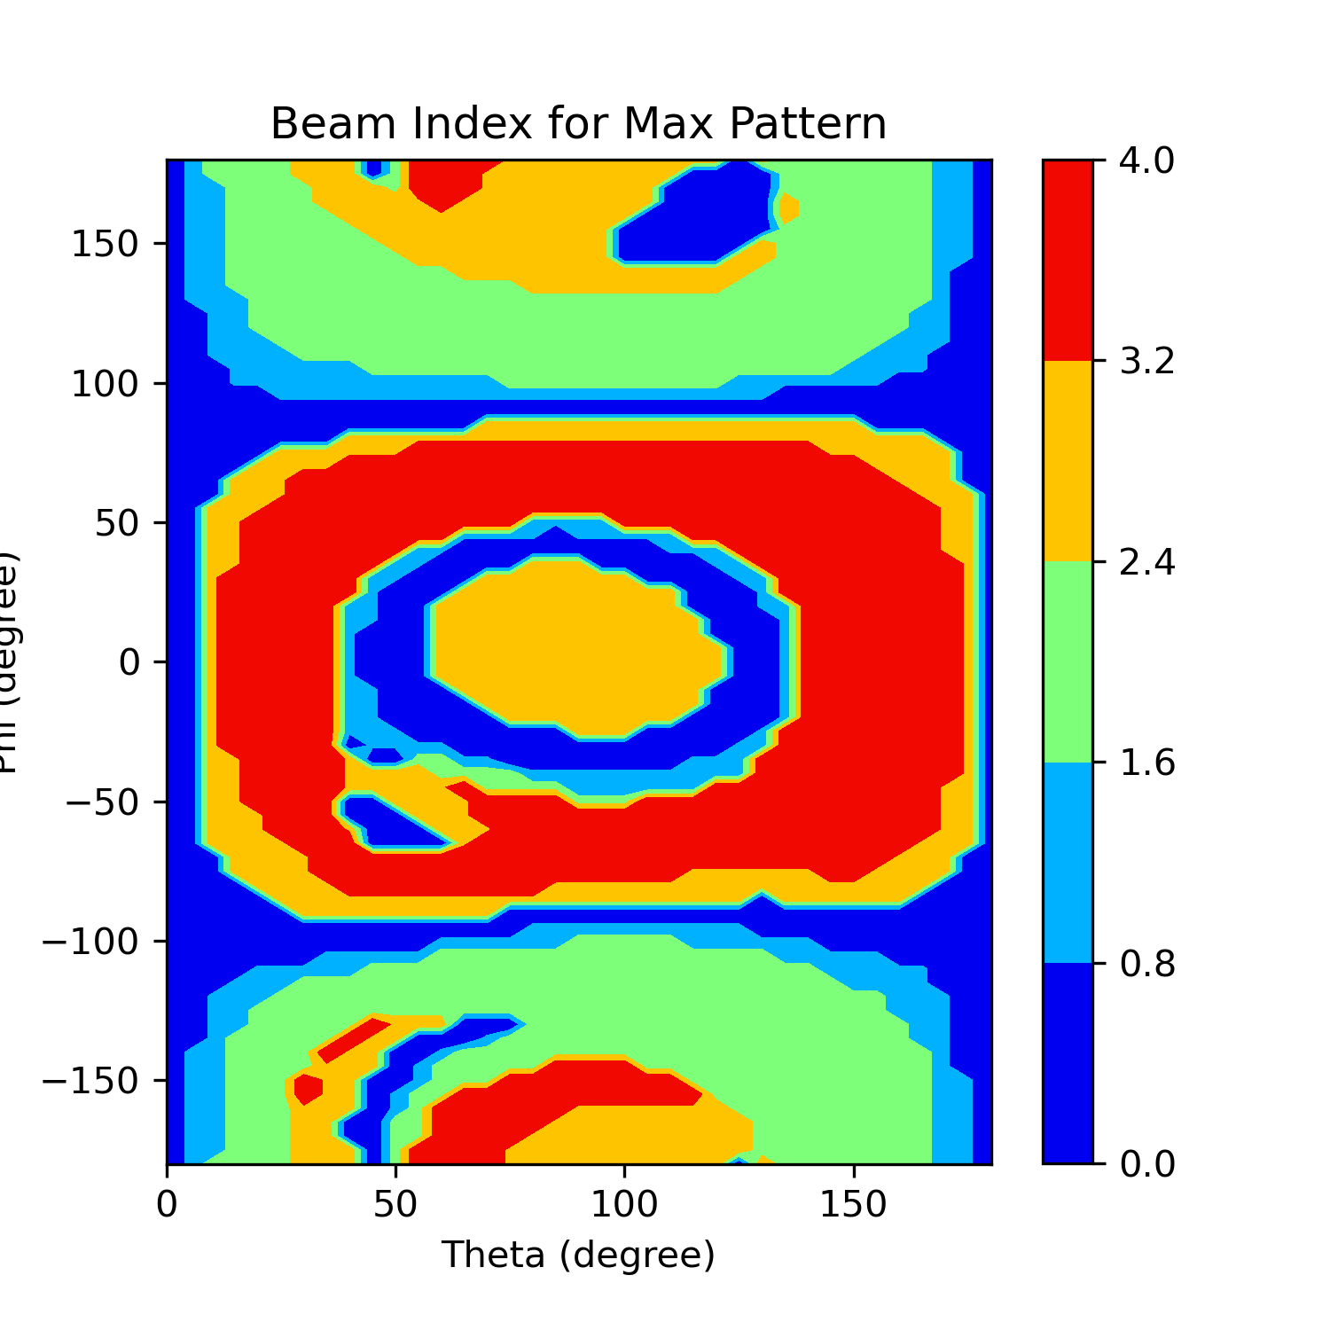

Slide 12
Usage

Slide 13
5G Wizard: Setup
Project/Design
Select from currently open projects and designs
Solution/Setup
Select from currently solved solutions.
Only solved points with saved fields will be selectable
Variation
Selection from available solution variation
Nominal is the variation that the design is currently set to
Note: Menu items will not refresh dynamically, exit wizard and reopen if something has changed in your desktop environments. For example, if you open a new project, complete a solution, or add a geometry, the menu items will not refresh until toolkit is reopened

Slide 14
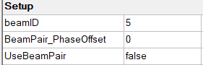
5G Wizard: Codebook
Codebook
CSV file that defines magnitude and phase of each port for a corresponding beam ID variable
Update Beam ID Codebook
If a codebook has never been defined, this will import the codebook from a csv file and create 3 post processing variables
These post processing variables will control the sources
The codebook values will be imported into HFSS > Edit Sources, allowing the excitations to be controlled with beamID post processing variable
For example, beamID can be set to any defined beamID and all ports will be updated
UseBeamPair can be toggled between true and false to indicate that the beam pair should be also excited along with the primary beam

Slide 15
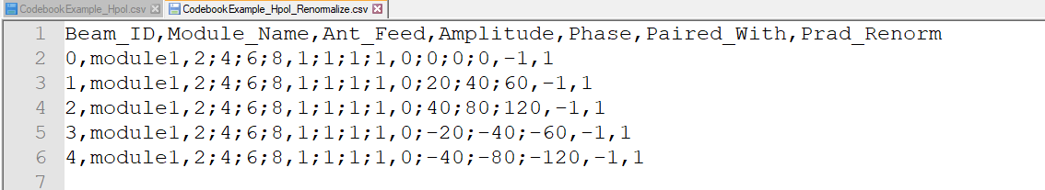
5G Wizard: Codebook Format
Codebook defined as CSV file
Each row entry is separated by comma
Multiple entries for a single column are separated by semi-colon “;”
Example provided and shown below
Organized as columns:
BeamID
Identification number (integer value)
Module_Name (optional parameter)
Useful for labeling output data
Ant_Feed (Port Name)
Port name as defined in your HFSS design
Ports not listed are assumed to be not excited for that beam ID
Amplitude and Phase correspond to location in adjacent columns
Name_Port1;Name_Port2,Mag_Port1;Mag_Port2,Phase_Port1;Phase_Port2
Amplitude
Units in Watts if using Driven Modal and Volts if using Driven Terminal
Phase
Phase of corresponding port name in degrees
Paired With
Which beam ID to activate when beam pair is used
Use “-1” if no beam pair exist
Prad_Renorm (optional, Watts)
Optional parameter allows renormalization of beam to user specified power
If not included, power will not be renormalized and based on the values defined in the codebook or as user has defined in the GUI
Using the codebook Prad_Renorm is useful in cases where you may be running multiple projects/designs/setups and each may have their own unique codebook
Optional

Slide 16
5G Wizard: Power Density
Evaluation Surface
User defined, rectangular surface
Can be model or non-model surface
Can exist inside or outside of solved solution domain
PD Averaging Area
Select from 1 or 4 cm^2, or create a user defined averaging area
Area is used to used to calculate average PD using algorigthm defined in IEEE specification
Sampling grid of fields is defined as 1mm or lambda/10, whichever is smaller
PD Type
PD_N_+, PD_Tot_+ or PD_Mod_+
Defined as equation (4), (5) and (8) in 63195-2
Power Renormalization
Allows beams to be renormalized to a total radiated power
A single value will renormalize all beams to that specified power
Multiple values ie. 1,1.5,1,4 would renormalize each beam to the respective power.

Slide 17
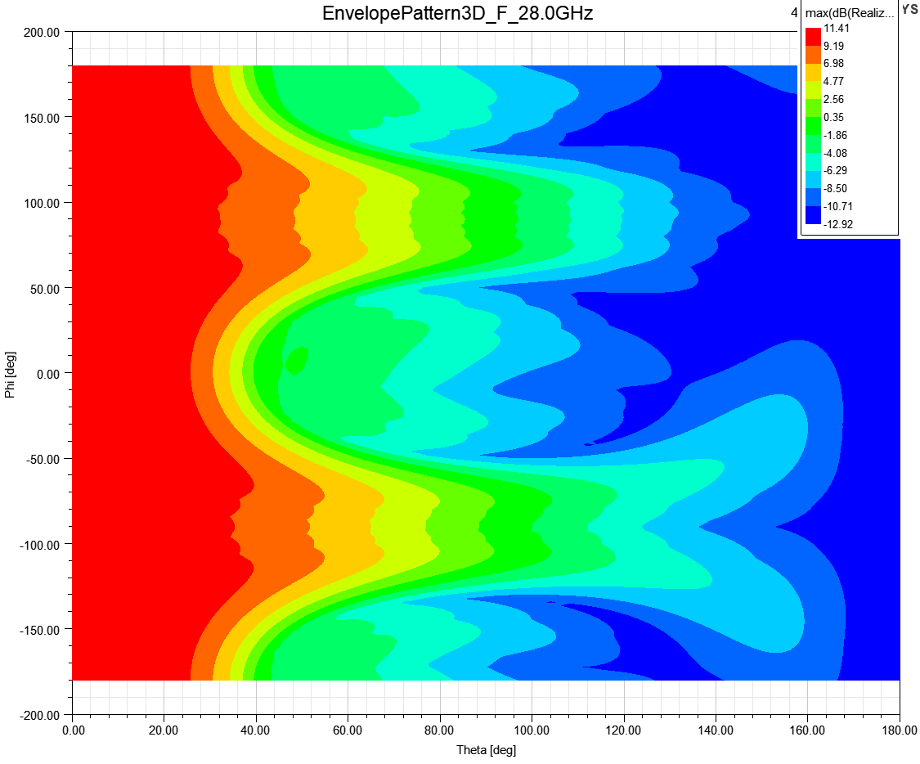
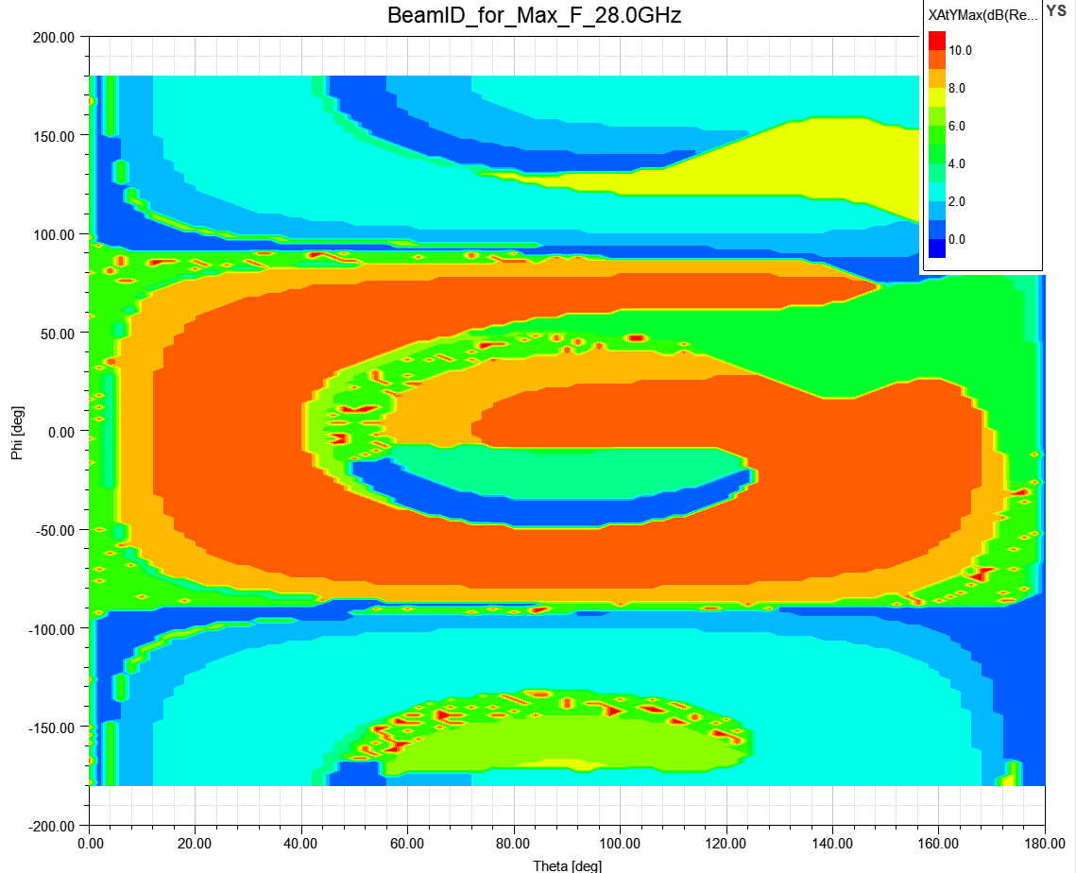
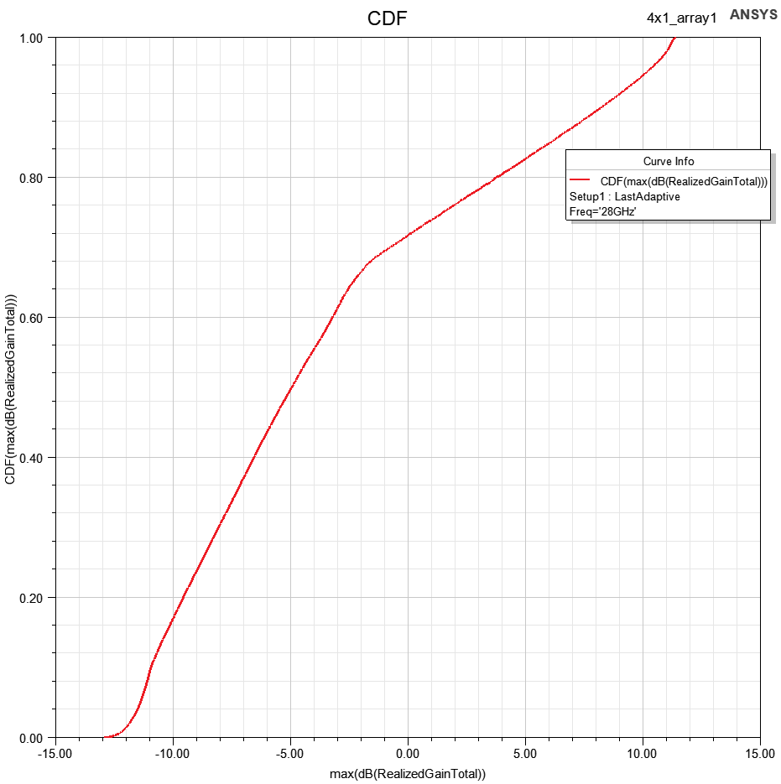
Cumulative Distribution Function
CDF Report
Envelope Pattern: Shows maximum value when evaluated over all beam ID’s
CDF Calculation:
CDF relative to selected CS
100th percentile renormalization can be applied to CDF output
Beam ID for Max: Shows which beam ID is used to achieve the maximum gain in every direction

Slide 18
Multi-Run select
Allows multiple setup to be run sequentially
CDF Multi-Run Example File
Each row is considering a single job, where CDF will be calculated for each job individually, and a summary across all jobs will also be reported. This allows one to calculate total CDF across multiple designs/projects
PD Multi-Run Example File
Each row is considering a single job, where PD will be calculated for each job individually, and a summary across all jobs will also be reported. The columns correspond to the entries in the GUI

Slide 19
Validation Data

Slide 20
Validation Data
Poynting Vector
(Reference Data)
PD_N_+ (Local)
PD_N_+
(Averaged 1cm^2)
PD_N_+ (Local)
PD_N_+
(Averaged 1cm^2)
PD_N_+
(Averaged 4cm^2)
PD_N_+
(Averaged 4cm^2)
PD_Tot_+ (Local)
Comparison
PD_Tot_+ (Local)
PD_Tot_+
(Averaged 1cm^2)
PD_Tot_+
(Averaged 1cm^2)
PD_Tot_+
(Averaged 4cm^2)
PD_Tot_+
(Averaged 4cm^2)
PD_Mod_+ (Local)
PD_Mod_+
(Averaged 1cm^2)
PD_Mod_+ (Local)
PD_Mod_+
(Averaged 1cm^2)
PD_Mod_+
(Averaged 4cm^2)
PD_Mod_+
(Averaged 4cm^2)
Reference Data
Provided by IEEE standard committee, based on original Poynting Vector reference data
5G Wizard Calculated from Poynting Vector reference data. The comparison show here will validate algorithms used in the 5G wizard for calculating local PD, and average PD

Slide 21
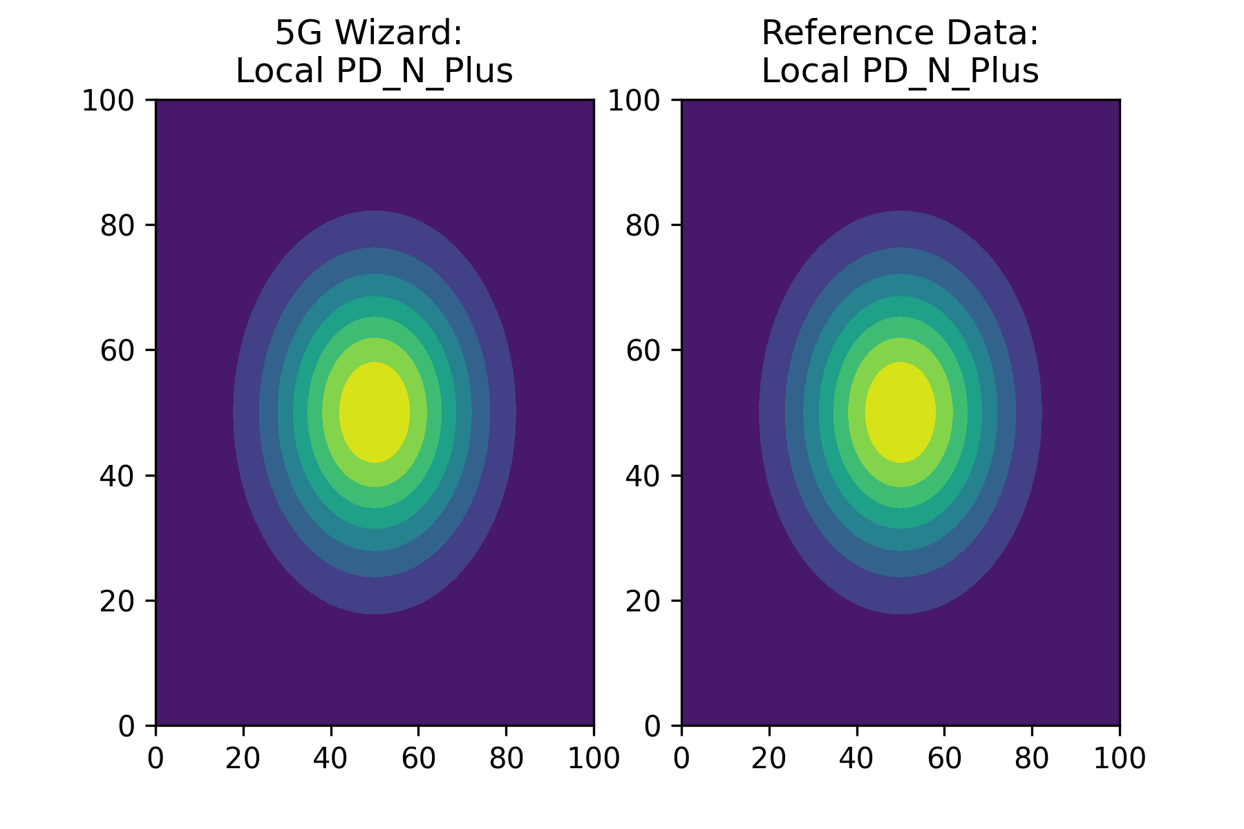
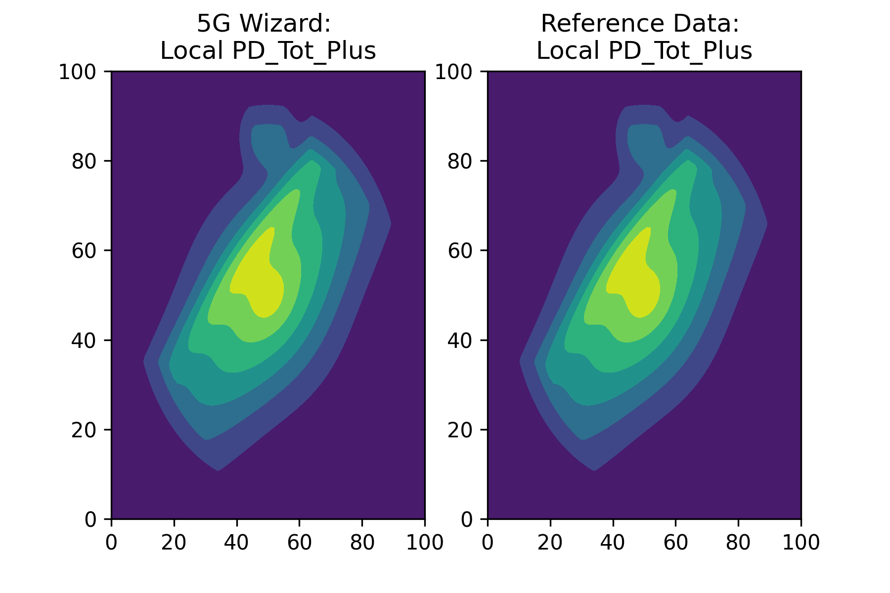
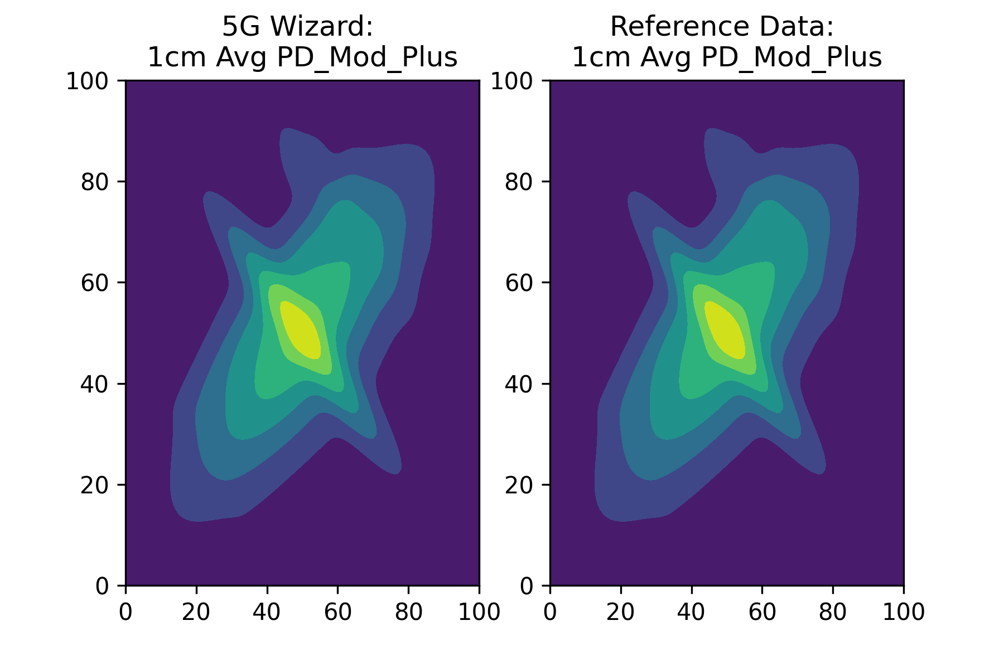
Local Comparison
PD_N_+ (Local)
PD_Tot_+ (Local)
PD_Mod_+ (Local)

Slide 22
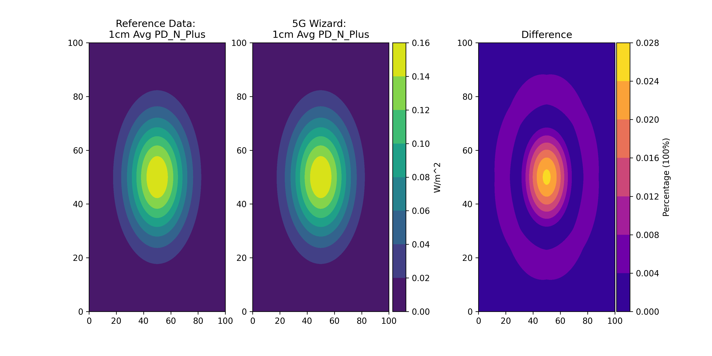
PD_N_+ Comparison: Averaging 1cm^2
PD_N_+
(Averaged 1cm^2)

Slide 23
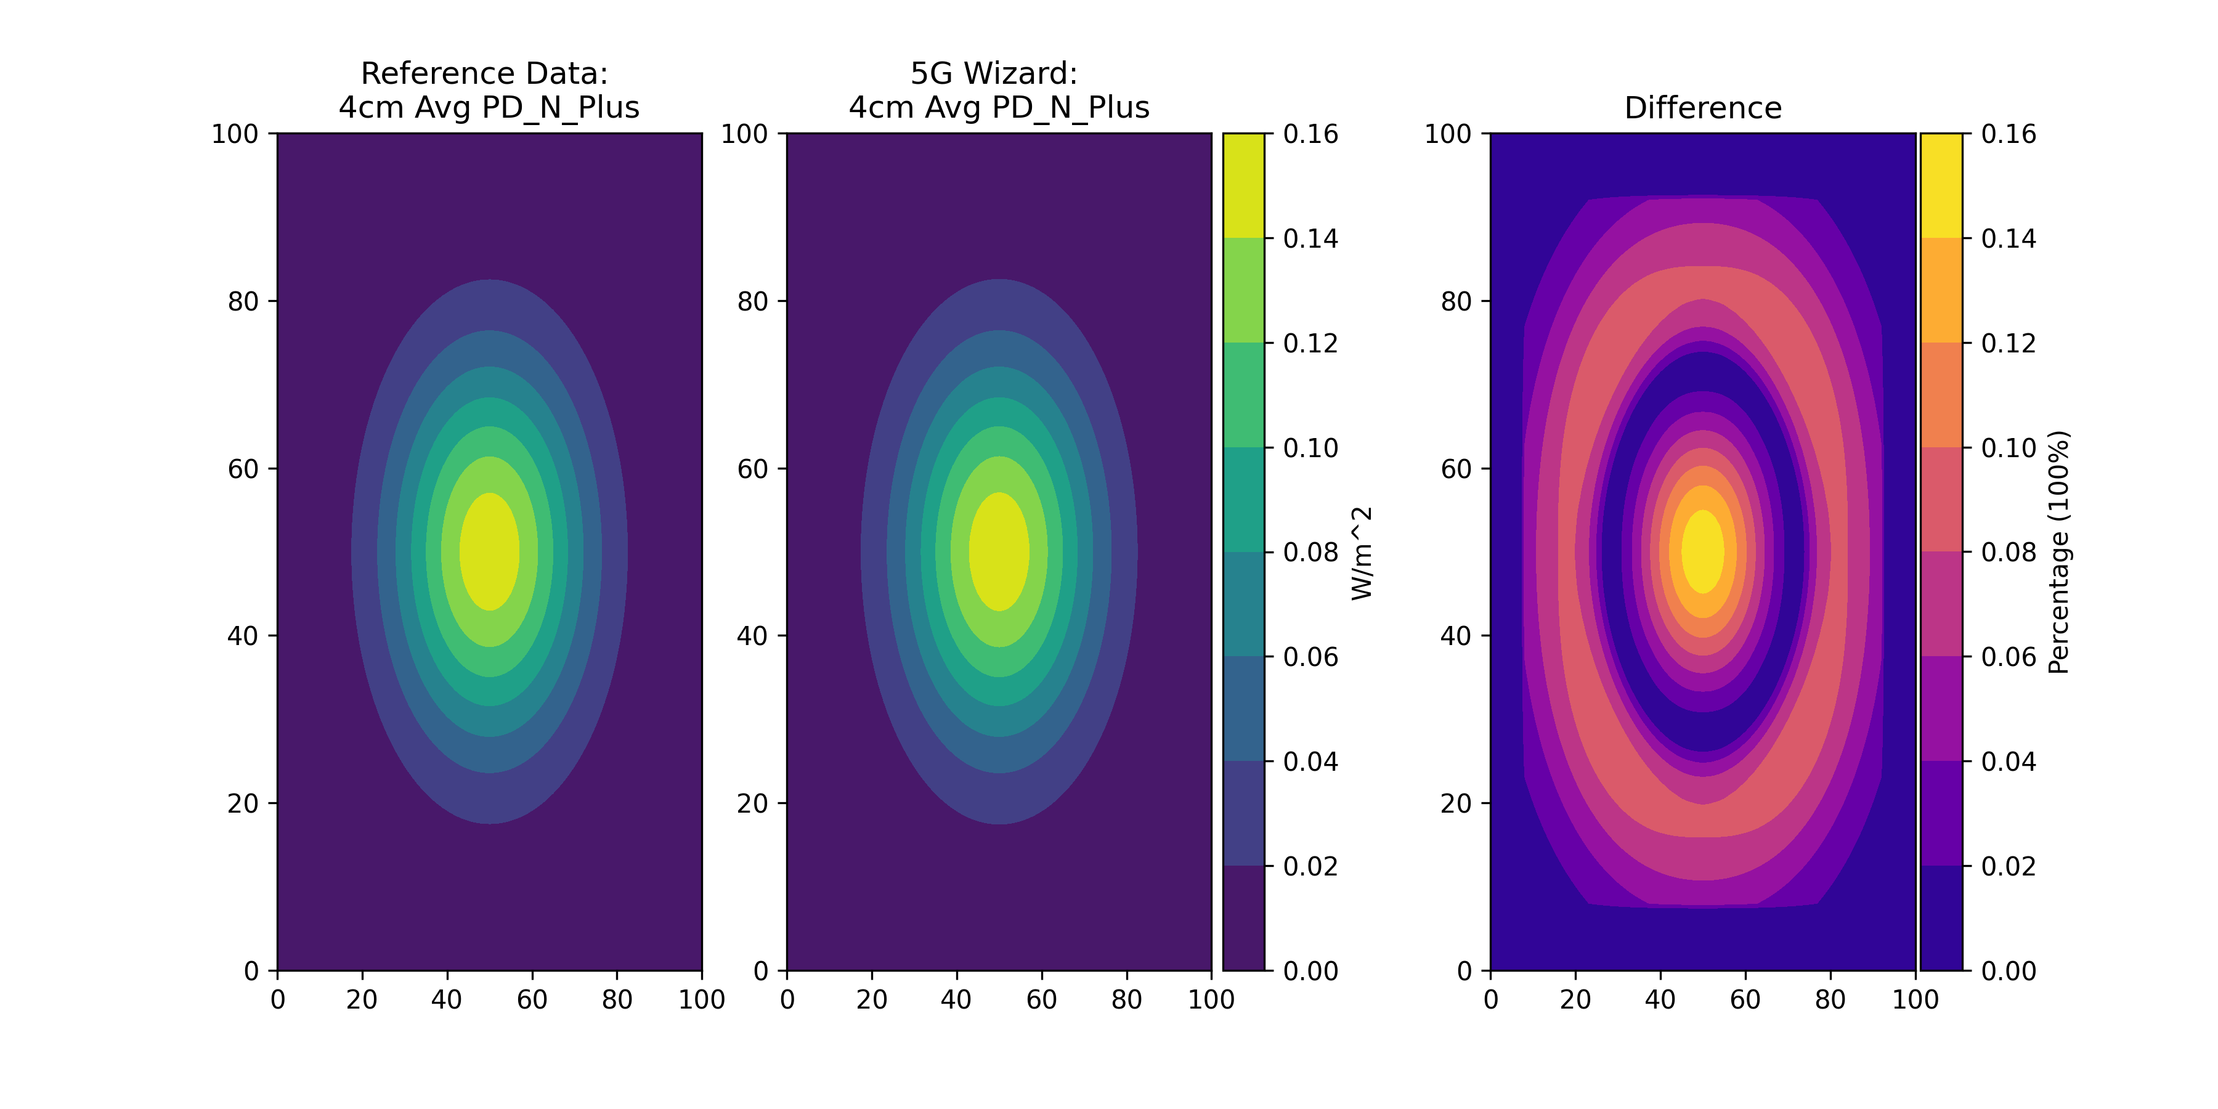
PD_N_+ Comparison: Averaging 4cm^2
PD_N_+
(Averaged 4cm^2)

Slide 24
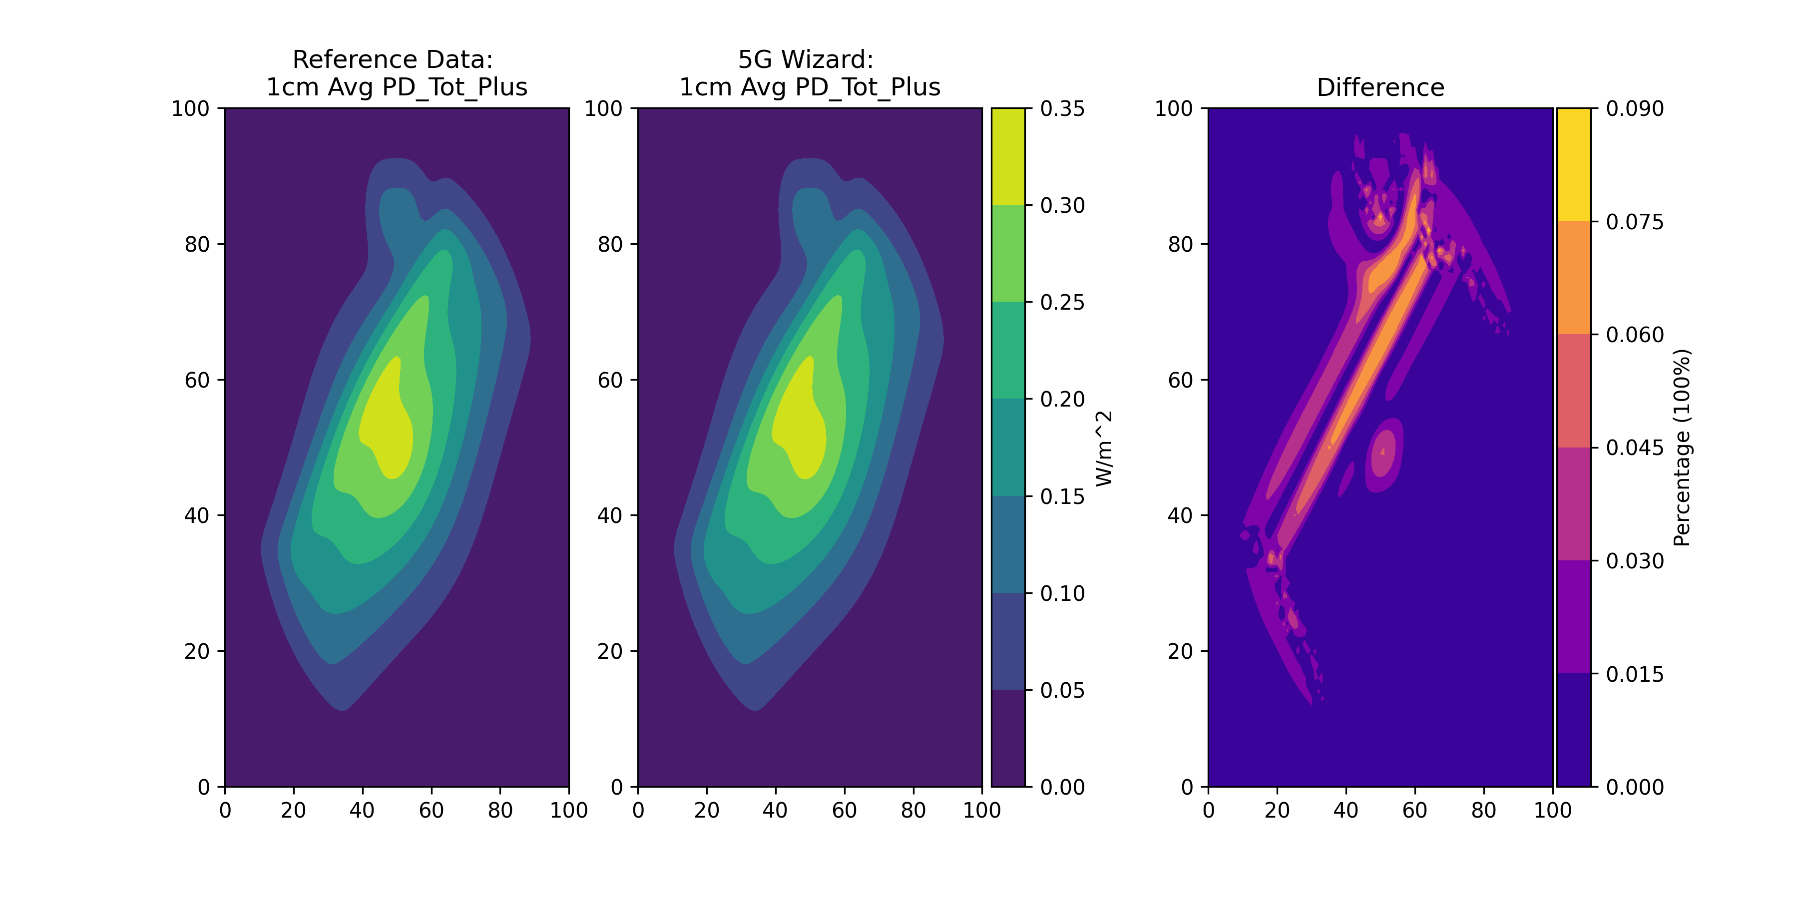
PD_Tot_+ Comparison: Averaging 1cm^2
PD_Tot_+
(Averaged 1cm^2)

Slide 25
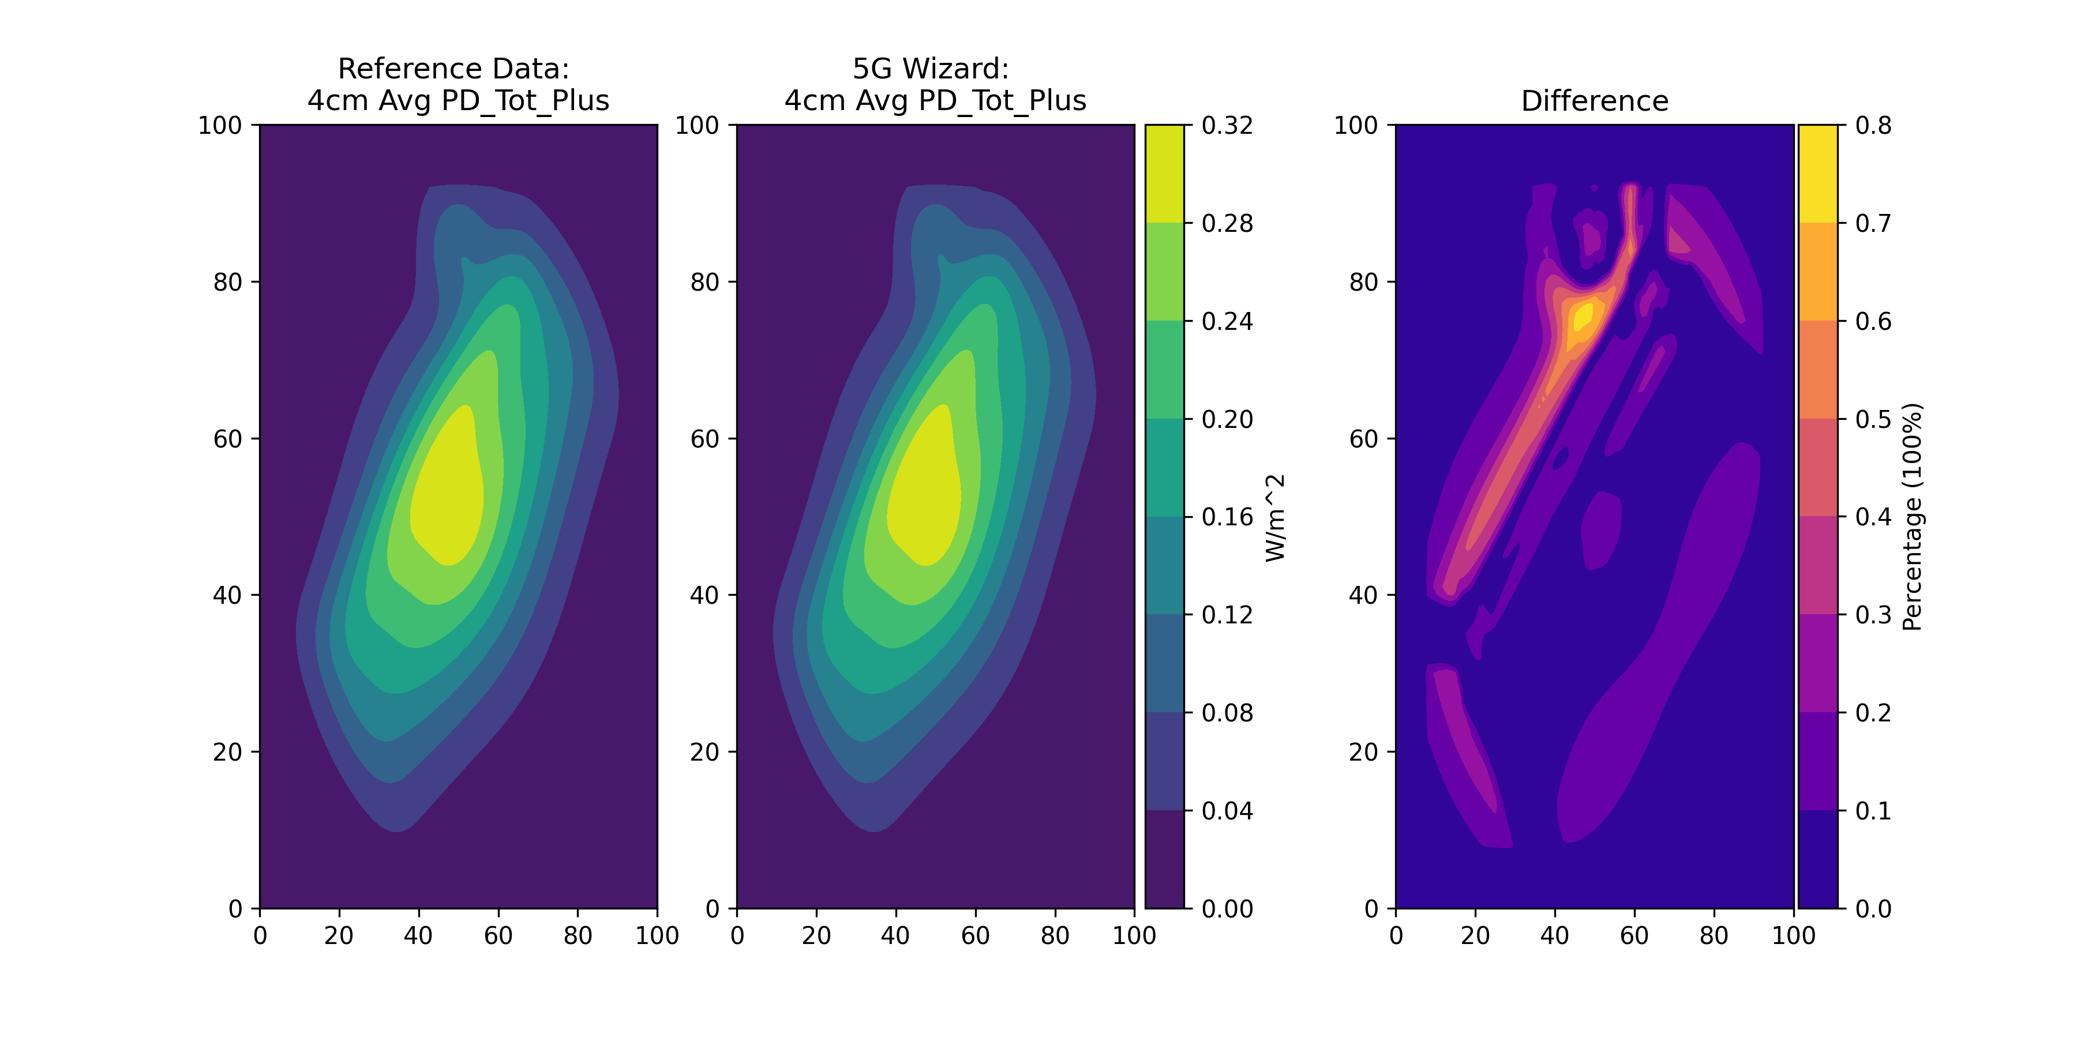
PD_Tot_+ Comparison: Averaging 4cm^2
PD_Tot_+
(Averaged 4cm^2)

Slide 26
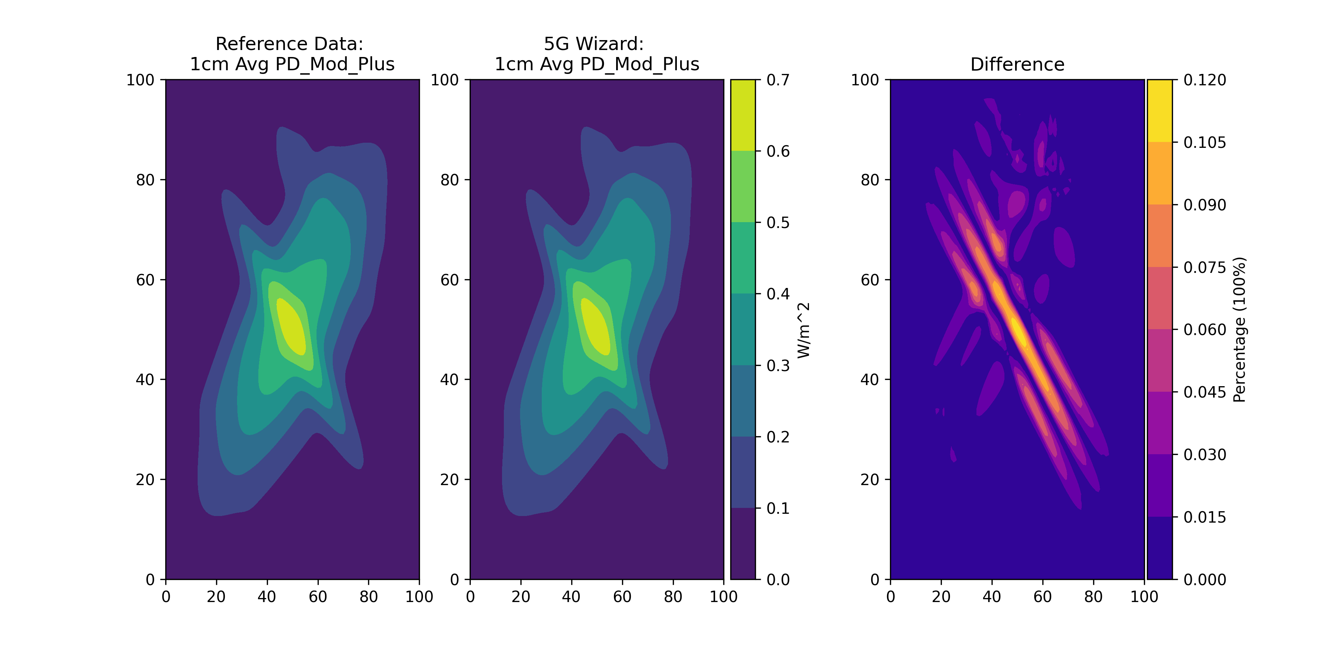
PD_Mod_+ Comparison: Averaging 1cm^2
PD_Mod_+
(Averaged 1cm^2)

Slide 27
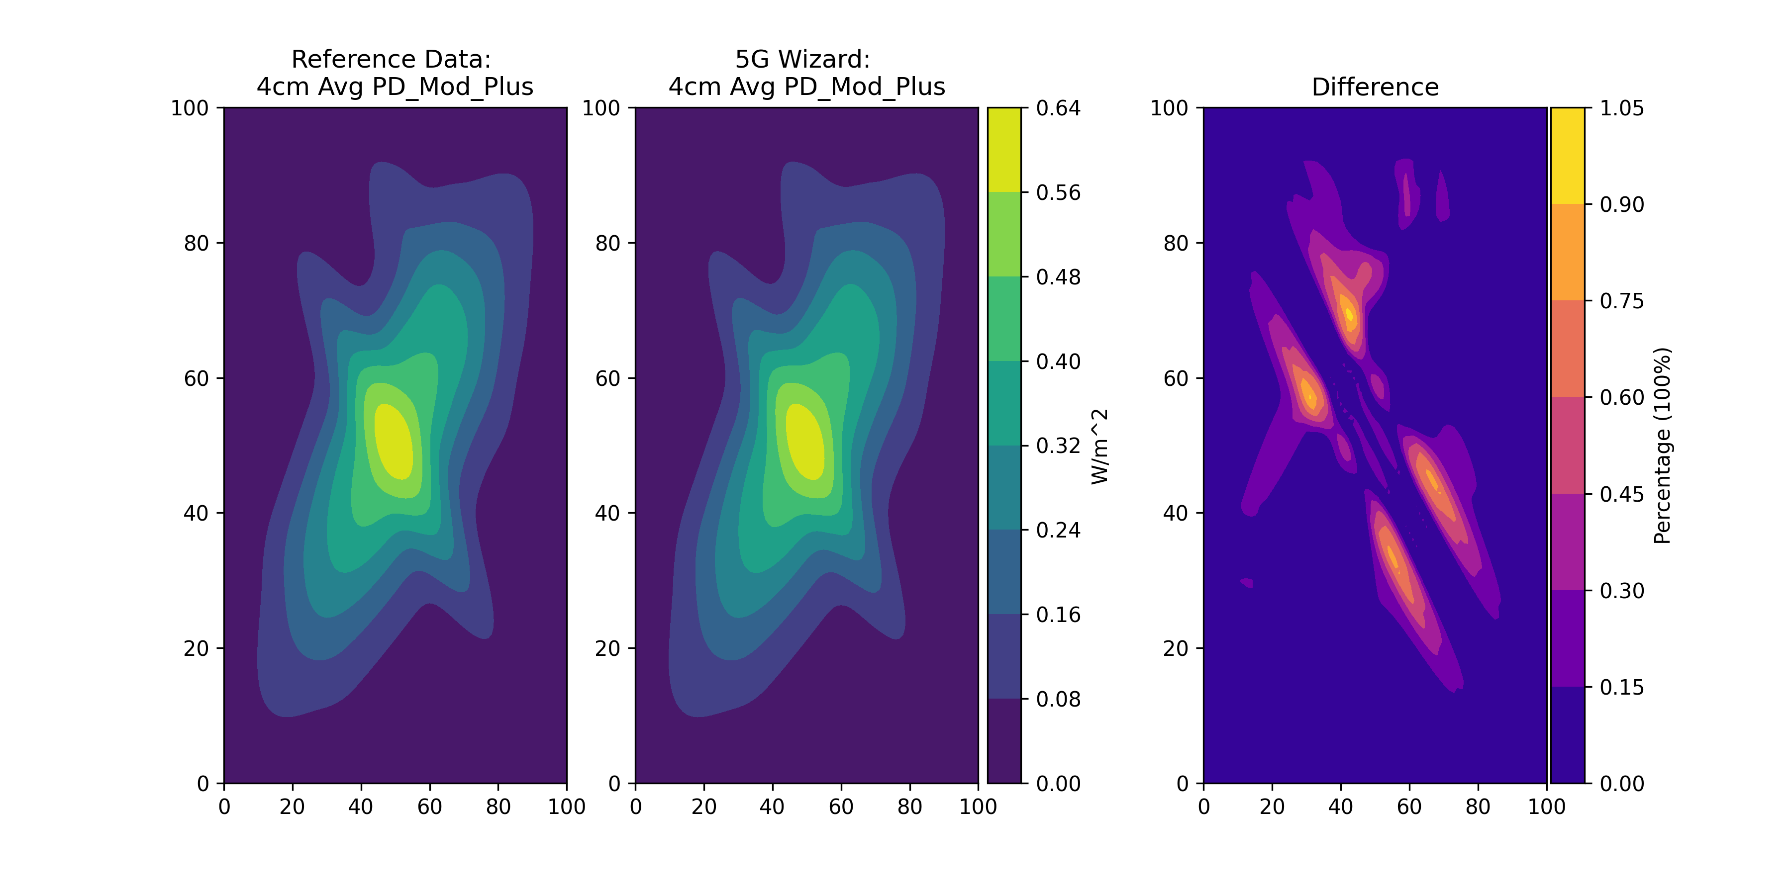
PD_Mod_+ Comparison: Averaging 4cm^2
PD_Mod_+
(Averaged 4cm^2)

Slide 28
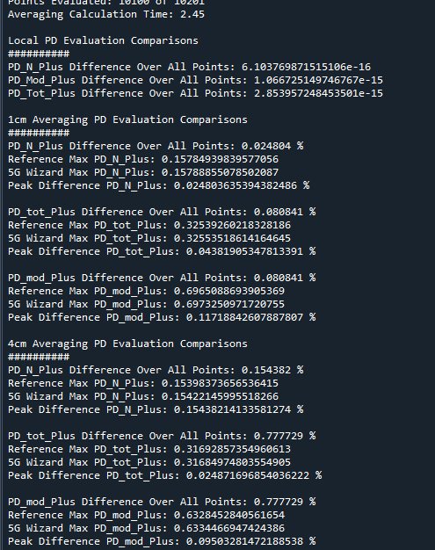
Comparison Summary
5G Wizard Calculation Time
~2.5 seconds for 1cm^2 surface per quantity
~ 3 seconds for 4cm^2 surface per quantity
Results are within 1% of reference data
Discussion:
The results will not be exactly the same because the reference data is based on analytic equations that can be re-evaluated at any requested point. In our simulations, and similar to how a measurement would be done, we are operating on a fixed grid of values that is not moved. For example, in the reference data, the grid of points to evaluate PD on is calculated. These points are fixed (x,y). When the average values are calculated at (x1,y1), a new set of grid points (x’,y’) are generated that align with the orientation of the averaging surface. As the averaging surface is rotated, a new set of points (x’,y’) are generated for each orientation.
No matter the orientation of the averaging square, a new set of points to evaluate that align with the averaging square. In the 5G wizard, because we are dealing with a fixed grid of points output from the simulation, when the averaging square rotates, for each rotation there may be a different set of points that fall within the averaging square. If a point does not fall within the averaging square at one rotation, it may fall within at another rotation.

